Slide 1

Columbus Neighborhoods and Houses Assessment
Sheng Guo
6/27/2020

Slide 2
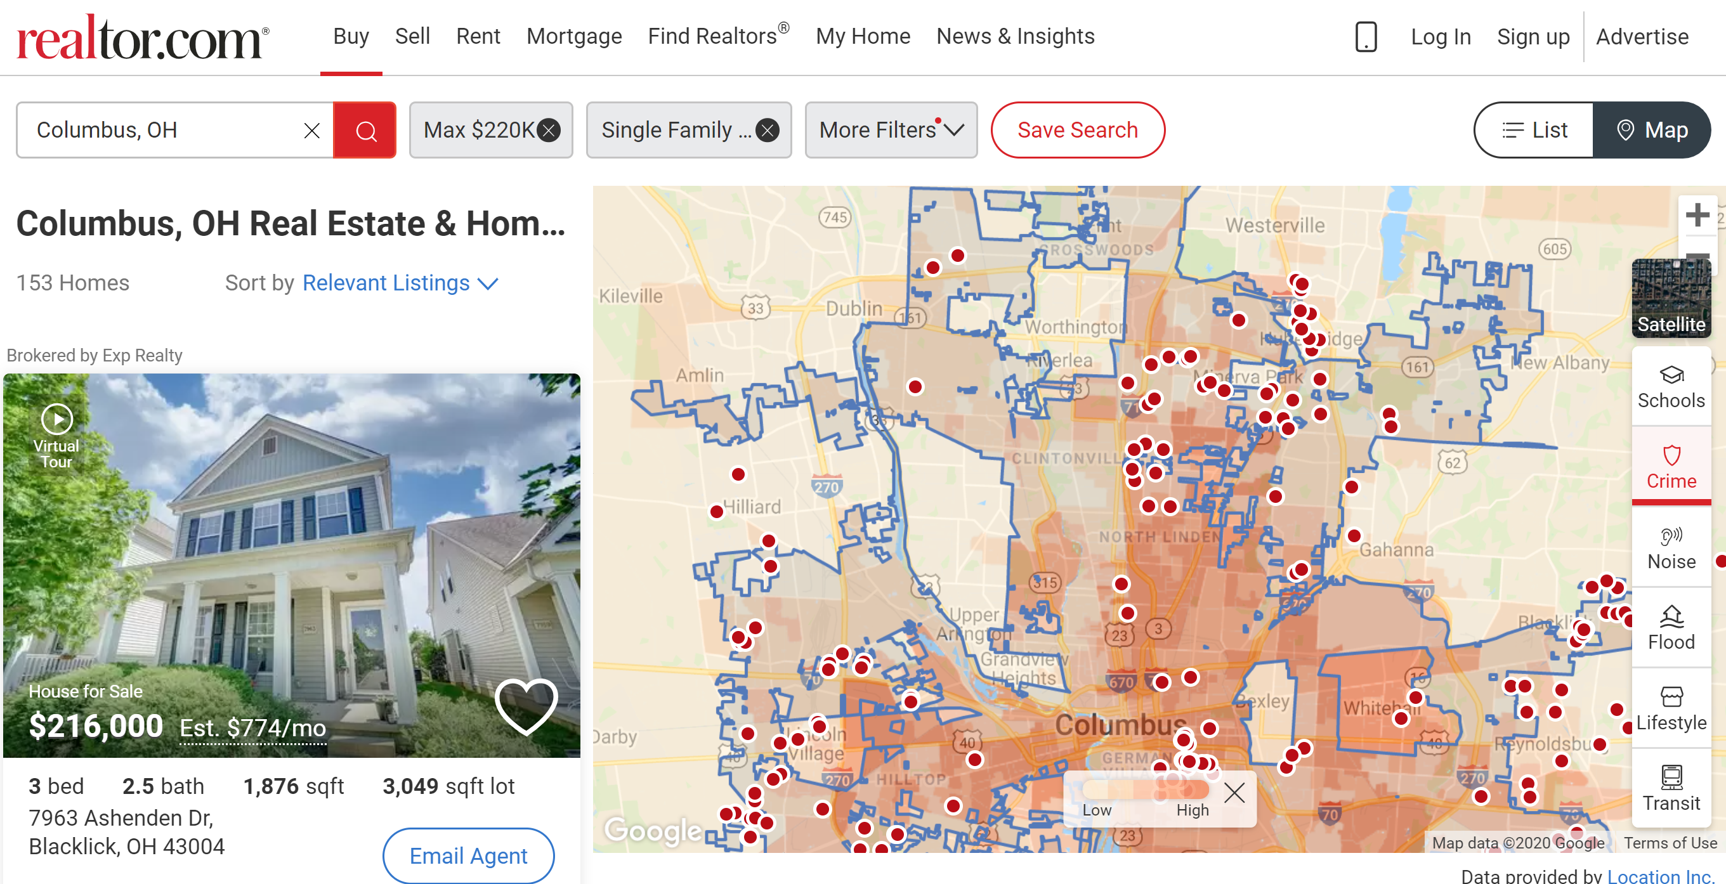
Background
Question: How to provide better assessment of neighborhoods and help clients to narrow down options from tons of houses?

Slide 3
Problem
Assess neighborhoods of selected houses in Columbus Ohio by looking at nearby venues, schools and crimes, and use the assessment to help clients to make decision of purchasing a house.

Slide 4
Data
Houses Information: The data was from Realtor.com. I selected 10 houses with the following filters: Location: Columbus OH; Price: from $180,000 to $220,000; Bedroom 3+; Bathroom 2+; Property Type: Single Family.
Nearby Venues: The data was obtained through Foursquare API. A list of recommended venues within a mile from the specified location was obtained through Foursquare API’s Venue Recommendations.

Slide 5
Data
Nearby Schools Information: The data was from greatschools.org. Public schools (including district and charter) within 5 miles from each selected house. The GreatSchools’ Summary Rating as the main evaluation each school. The Top 1 school's score, Top 3 schools' average scores and the total number for elementary, middle and high schools respectively are collected.
Crimes Information: The data is from Location Inc’s website https://locationinc.com/claim-probability-tools/residential-crime-claim/. The CrimeRisk™ Score and Probability of a Crime Claim from the website were collected.

Slide 6
Data
Clients’ Preference Weight: To personalize the assessment for clients, I designed a Clients’ Preference Weight form to collect clients’ preference. Clients are asked to put weight (from 0 to 10) on the significance of each specific category related to nearby venues, nearby schools in their consideration.

Slide 7
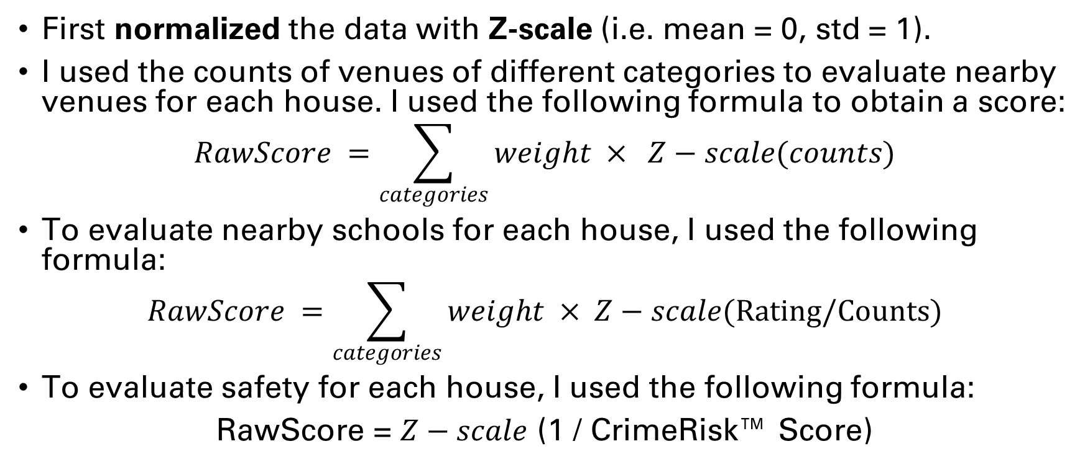
Evaluation of neighborhoods
First normalized the data with Z-scale (i.e. mean = 0, std = 1).
I used the counts of venues of different categories to evaluate nearby venues for each house. I used the following formula to obtain a score:
$$RawScore =\sum_{categories}{weight × Z−scale(counts)}$$
To evaluate nearby schools for each house, I used the following formula:
$$RawScore =\sum_{categories}{weight × Z−scale(Rating/Counts})$$
To evaluate safety for each house, I used the following formula:
RawScore = $Z−scale$ (1 / CrimeRisk™ Score)

Slide 8
Evaluation of neighborhoods
Then I used the following formula to obtain the regularized score:
Score = RawScore × 20 + 50
From above formula, the average score is 50. The further above from 50, the better; the further below from 50, the worse. The neighborhoods score is the average of the scores of nearby venues, nearby schools, and safety.

Slide 9
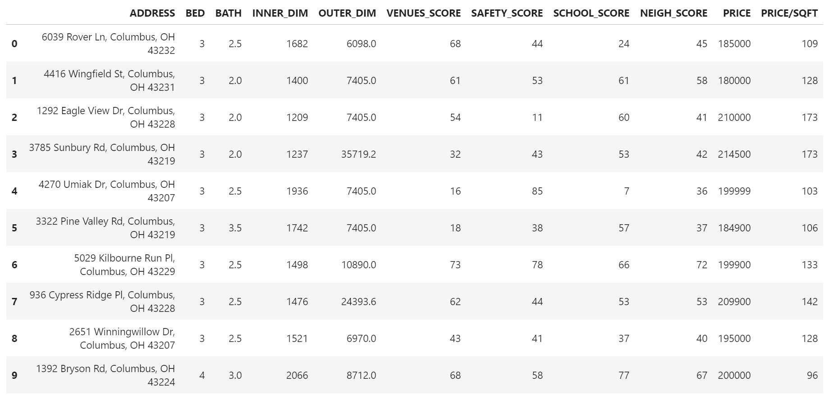
Results

Slide 10
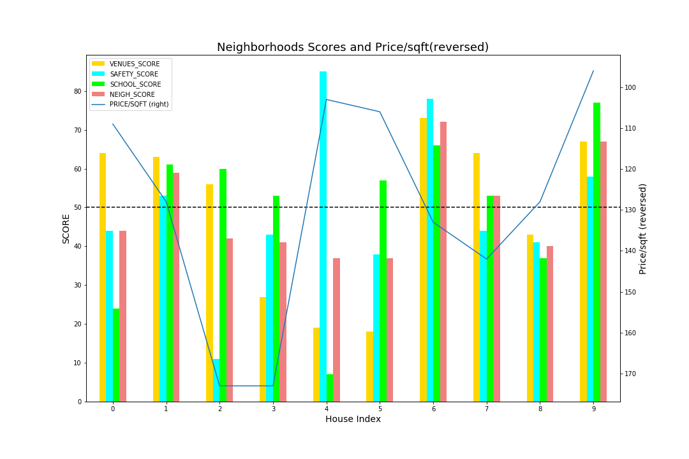
Results

Slide 11
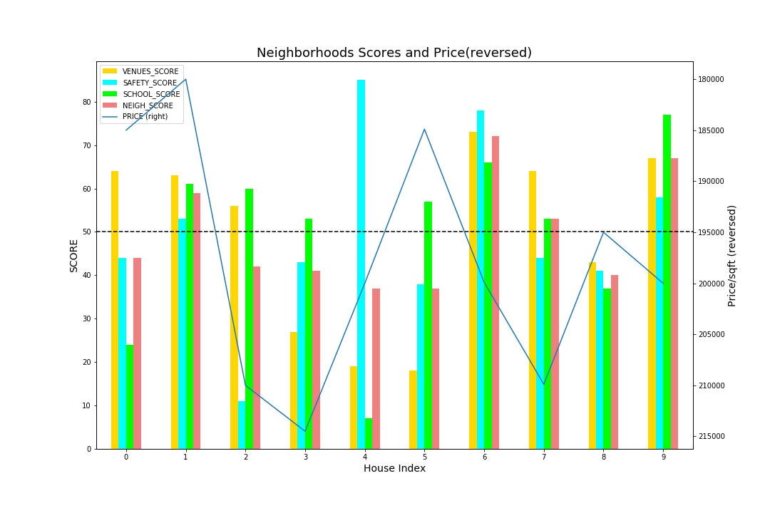
Results

Slide 12
Conclusion and discussion
I will strongly recommend the clients to first consider House 1, 6, 7 and 9 based on Figure 6 and Figure 7. These houses have relatively high neighborhoods score while relatively low unit price.

Slide 13
Conclusion and discussion
I believe better data accessibility can help to improve neighborhoods assessment. Even though I only chose 10 houses in this report to reduce the amount of work, but real estate related API can be used to access large amount of housing data. With similar data analysis above, we can offer clients with better options and more persuasive suggestions in a larger pool of housing in a reasonably short time.

